Slide 1
Support Vector Machine
(Refer Ethem Alpaydin for SVM)

Slide 2
Definition
Given a dataset consisting of features from more than one class, SVM classifier constructs hyperplanes that separate the observations of different classes.

Slide 3
Linear Classifiers
denotes +1
denotes -1
w x + b>0
w x + b=0
How would you classify this data?
w x + b<0

Slide 4
α
Linear Classifiers
x
f
y^{est}
f(x,w,b) = sign(w x + b)
denotes +1
denotes -1
How would you classify this data?

Slide 5
α
Linear Classifiers
x
f
y^{est}
f(x,w,b) = sign(w x + b)
denotes +1
denotes -1
How would you classify this data?

Slide 6
α
Linear Classifiers
x
f
y^{est}
f(x,w,b) = sign(w x + b)
denotes +1
denotes -1
Any of these would be fine..
..but which is best?

Slide 7
α
Linear Classifiers
x
f
y^{est}
f(x,w,b) = sign(w x + b)
denotes +1
denotes -1
Any of these would be fine..
..but which is best?

Slide 8
α
Linear Classifiers
x
f
y^{est}
f(x,w,b) = sign(w x + b)
denotes +1
denotes -1
How would you classify this data?
Misclassified
to +1 class

Slide 9
α
α
Classifier Margin
Classifier Margin
x
x
f
f
y^{est}
y^{est}
f(x,w,b) = sign(w x + b)
f(x,w,b) = sign(w x + b)
denotes +1
denotes -1
denotes +1
denotes -1
Define the margin of a linear classifier as the width that the boundary could be increased by before hitting a datapoint.
Define the margin of a linear classifier as the width that the boundary could be increased by before hitting a datapoint.

Slide 10
Maximizing the margin is good according to intuition and PAC theory
Implies that only support vectors are important; other training examples are ignorable.
Empirically it works very very well.
α
Maximum Margin
x
f
y^{est}
f(x,w,b) = sign(w x + b)
denotes +1
denotes -1
The maximum margin linear classifier is the linear classifier with the, um, maximum margin.
This is the simplest kind of SVM (Called an LSVM)
Support Vectors are those datapoints that the margin pushes up against
Linear SVM

Slide 11
Linear SVM Mathematically
x⁺
M=Margin Width
“Predict Class = +1” zone
X⁻
wx+b=1
“Predict Class = -1” zone
wx+b=0
wx+b=-1
What we know:
w . x⁺ + b = +1
w . x⁻ + b = -1
w . (x⁺-x⁻⁾ = 2

Slide 12
Linear SVM Mathematically
Goal: 1) Correctly classify all training data
if y_{i} = +1
if y_{i} = -1
for all i
2) Maximize the Margin
same as minimize
We can formulate a Quadratic Optimization Problem and solve for w and b
Minimize
subject to

Slide 13
Optimization Problem
Need to optimize a quadratic function subject to linear constraints.
Quadratic optimization problems are a well-known class of mathematical programming problems, and many (rather intricate) algorithms exist for solving them.
The solution involves constructing a dual problem where a Lagrange multiplier α_{i} is associated with every constraint in the primary problem:

Slide 14
Constrained Optimization Problem

Slide 15
Quadratic Programming
Why is this reformulation a good thing?
The problem is an instance of what is called a positive, semi-definite programming problem
Most of will be zero. The set of x for which >0 is called as support vectors.
For a fixed real-number accuracy, can be solved in O(n log n) time = O(|D|² log |D|²)

Slide 16
The Optimization Problem Solution
The solution has the form:
Each non-zero α_{i} indicates that corresponding x_{i} is a support vector.
Then the classifying function will have the form:
Notice that it relies on an inner product between the test point x and the support vectors x_{i} – we will return to this later.
Also keep in mind that solving the optimization problem involved computing the inner products x_{i}^{T}x_{j} between all pairs of training points.
w =Σα_{i}y_{i}x_{i} b= y_{k}- w^{T}x_{k} for any x_{k} such that α_{k}≠ 0
f(x) = Σα_{i}y_{i}x_{i}^{T}x + b

Slide 17
After calculating support vectors
w is computed as the weighted sum of support vectors
W0 is computed by substituting the values of w and x

Slide 18
Problems with linear SVM
=-1
=+1
What if the decision function is not a linear?

Slide 19
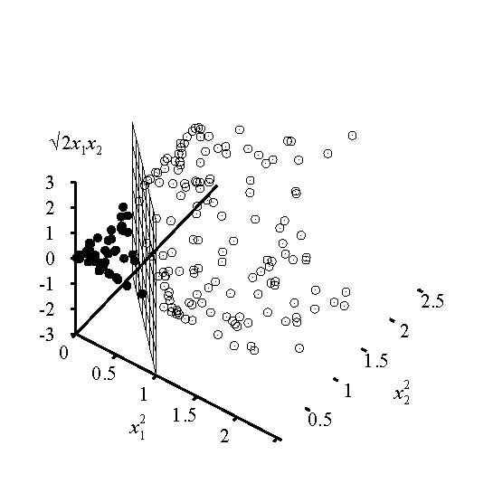
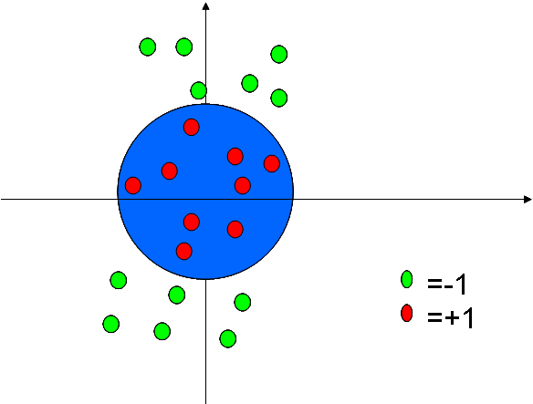
Kernel Trick

Slide 20
Other Kernels
The polynomial kernel
K(x_{i},x_{j}) = (x_{i}•x_{j} + 1)^{p}, where p is a tunable parameter.
Evaluating K only require one addition and one exponentiation
more than the original dot product.
Gaussian kernels (also called radius basis functions)
K(x_{i},x_{j}) = exp(||x_{i}-x_{j} ||²/2σ²)

